Slide 1
ECE 385 Midterm Review
Originally Created by Yikuan Chen,
Modified by Yanpei Tian 13:00 Oct 6th 2018
Modified by Neil Varghese, Keshav Harisrikanth Feb 22nd 2019

Slide 2
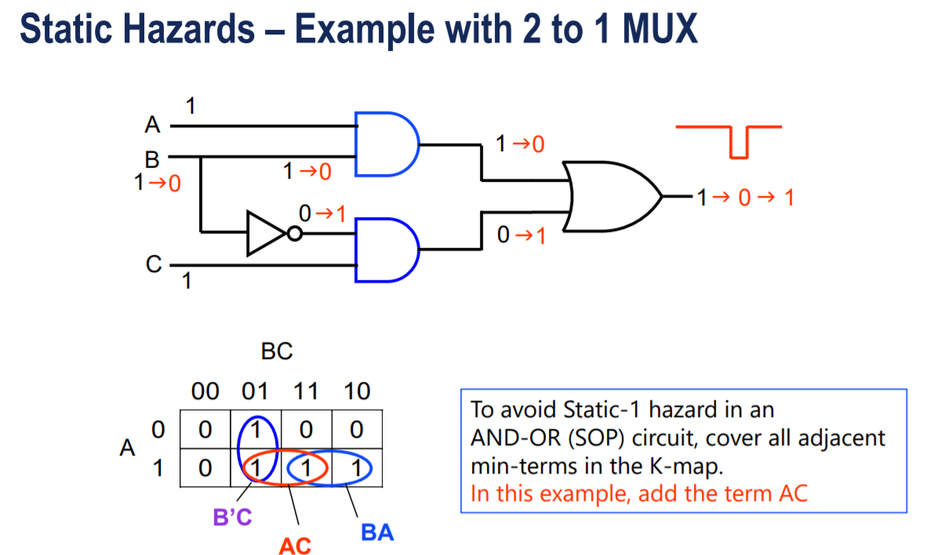
Lab 1

Slide 3
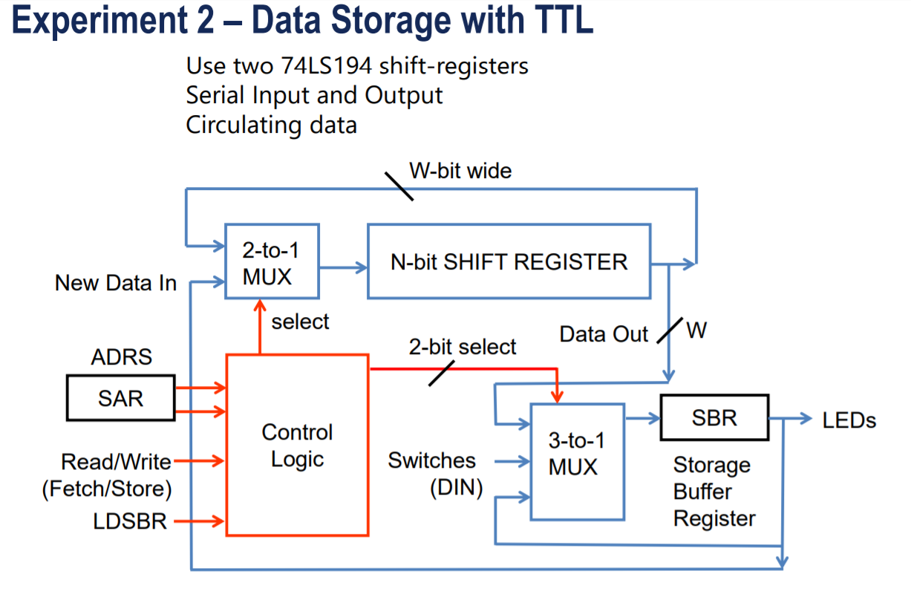
Lab 2

Slide 4
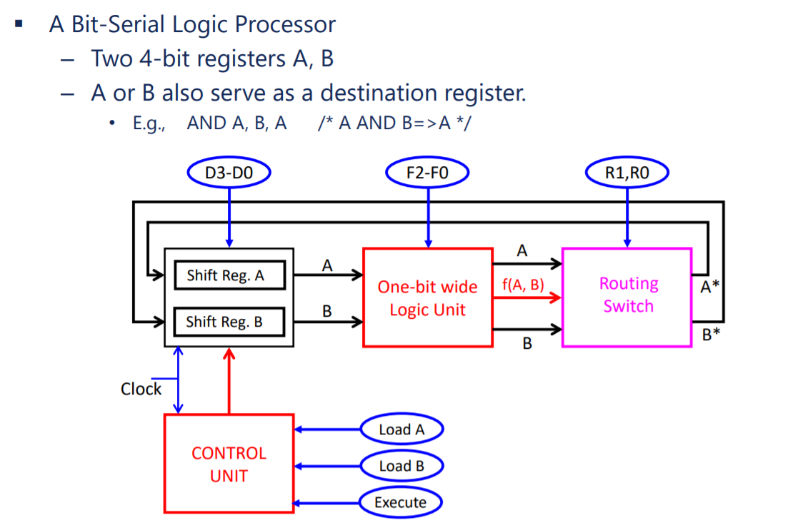
Lab 3

Slide 5
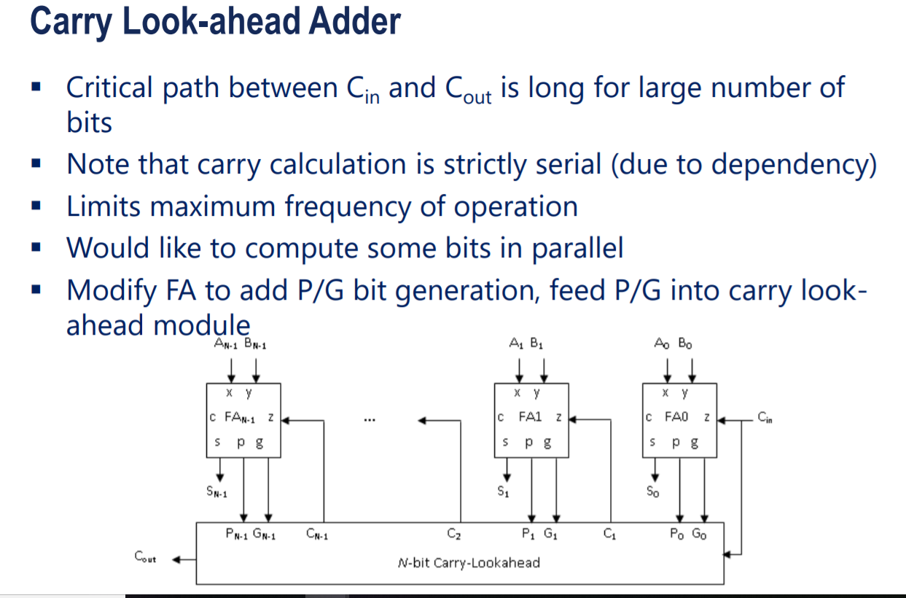
Lab 4

Slide 6
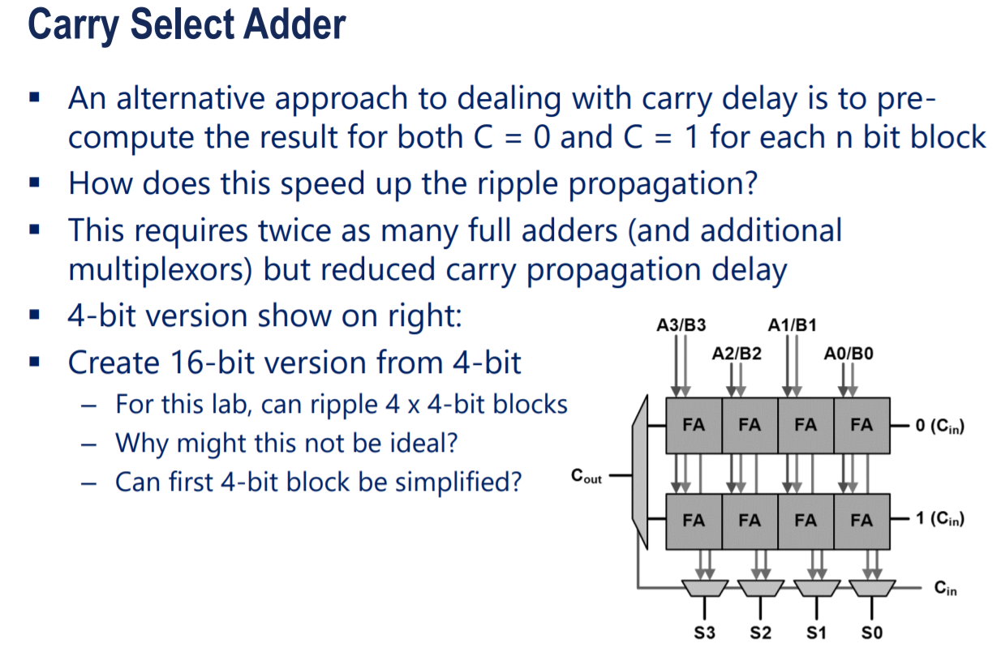
Lab 4 (Cont.)

Slide 7
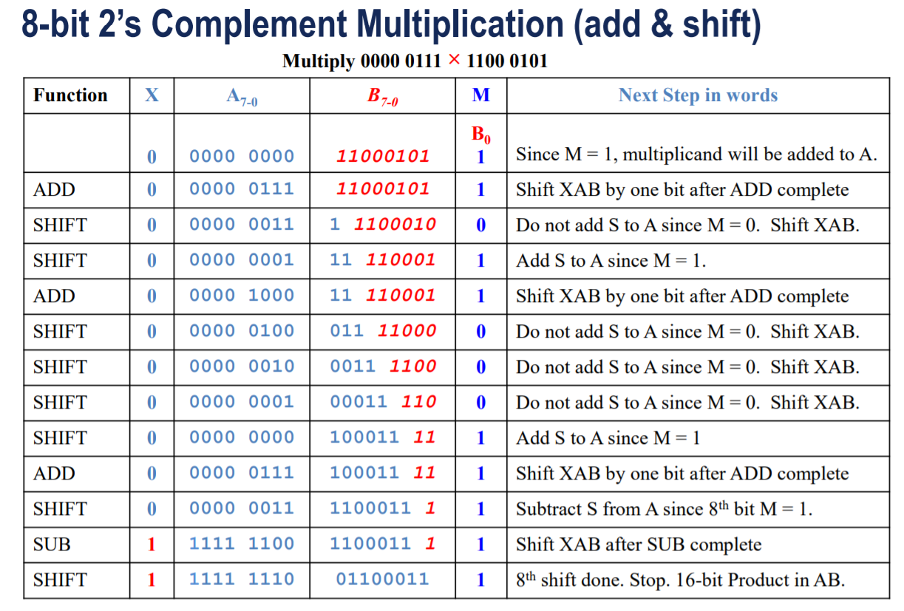
Lab 5

Slide 8
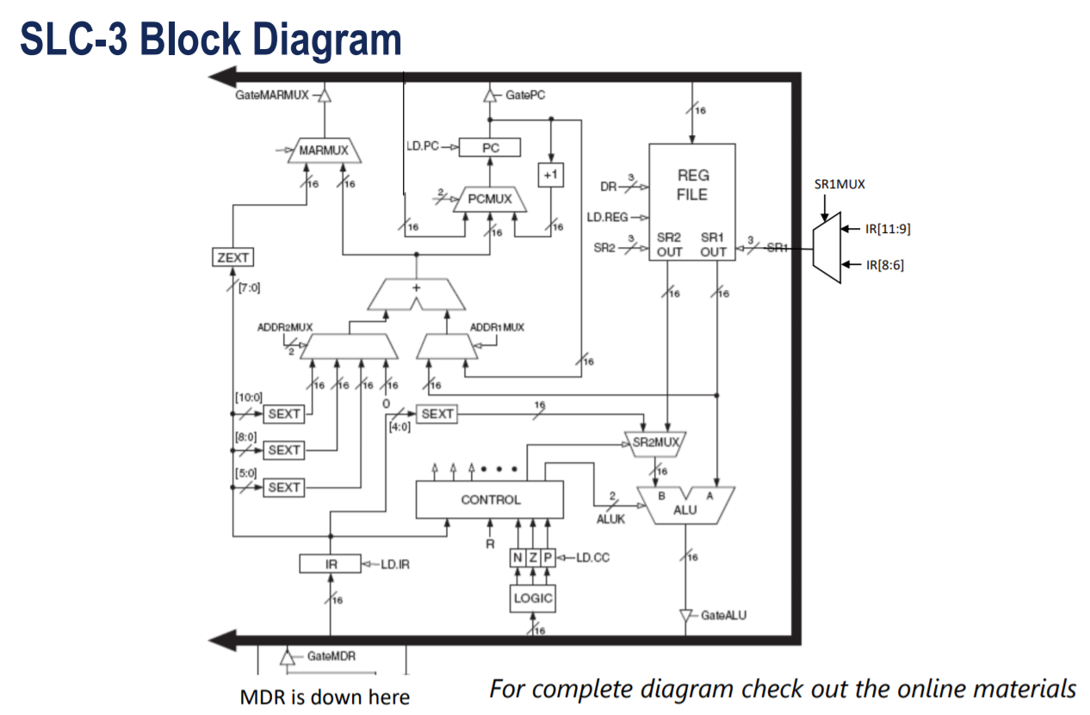
Lab 6 (Don’t worry about it)
Won’t be on this exam.
Not even week 1.
Expect a more on the final.
When it does show up, expect questions on how memory was handled.

Slide 9
Difficulty of Exam Questions
★ easy, ★ ★ medium, ★ ★ ★ hard
All are single correct answer multiple choice questions.
30 minutes long. Need No.2 (HB) pencil.
~66% based on Labs. ~33% based on Lectures.
★ ~20% (about 6 problems)
★ ★ ~40% (about 12-13 problems)
★ ★ ★ ~30% (about 8-9 problems)
Notes:
Exam score will not curve. The total score will be curved slightly at the end of semester on a section-wise basis. Mine curved from 319 to 323 so not much.

Slide 10
Difficulty of Exam Questions
★ easy, ★ ★ medium, ★ ★ ★ hard
Older sample problems on wiki may not reflect the difficulty of the real test.
Study lecture slides.
Notes:
Exam score will not curve. The total score will be curved slightly at the end of semester on a section-wise basis. Mine curved from 319 to 323 so not much.

Slide 11
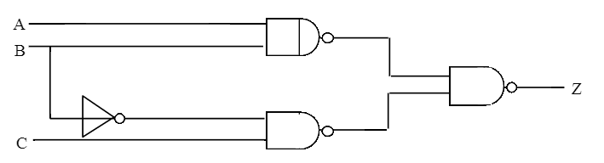
1.For the following circuit from Lab 1, will static-0 hazard happen when we switch in between A,B,C = 000 and 010?
Yes
No

Slide 12
1.For the following circuit from Lab 1, will static-0 hazard happen when we switch in between A,B,C = 000 and 010?
B \ AC | 00 | 01 | 11 | 10
0 | 0 | 1 | 1 | 0
1 | 0 | 0 | 1 | 1
Yes
No
Transition from 000 to 010 (toggling B) will not cause the output to change from 0 to 1 because no matter what B is, as long as A and C remains 0, the NAND gate will always give a 1 and hence the output Z is always 0.
★
Notes:
B becomes don’t care

Slide 13
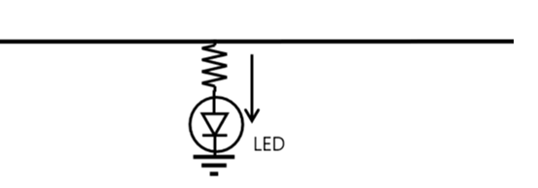
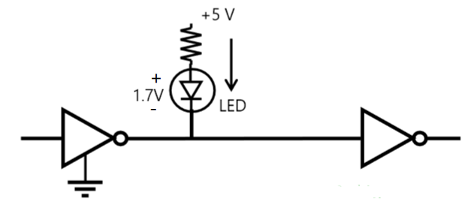
2. What is the correct way to connect LED chip to show the value of logic x (which is at an arbitrary place in the circuit)?
Other logic
Other logic
A logic x
B logic x

Slide 14
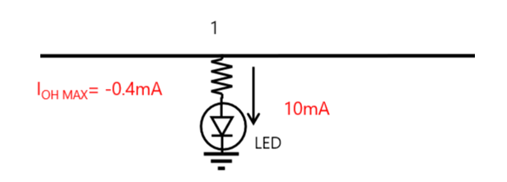
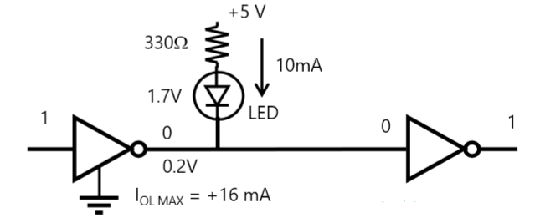
2. What is the correct way to connect LED chip to show the value of logic x (which is at an arbitrary place in the circuit)?
A logic x
B logic x
Other logic
Other logic
No enough current
Vcc provides current for LED
★★

Slide 15
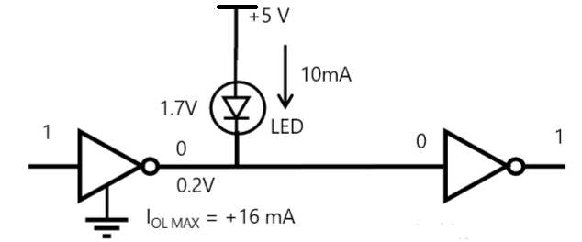
2. How about this?
Other logic
Other logic
A logic x
B logic x

Slide 16
2. How about this?
A logic x
B logic x
Other logic
Other logic
3.3V here?
0V here?
3.3V across R
★★
Notes:
Conflicting voltage level

Slide 17
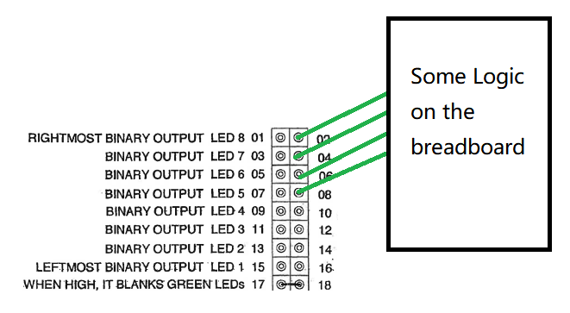
3. A student connected 4bits in shift register A to the switch box in the following way, but the LED does not correctly reflect the values in the shift reg. The switch box and his logics are error free. What had gone wrong?

Slide 18
3. A student connected 4bits in shift register A to the switch box in the following way, but the LED does not correctly reflect the values in the shift reg. The switch box and his logics are error free. What had gone wrong?
Even number pins are GND of switch box!

Slide 19
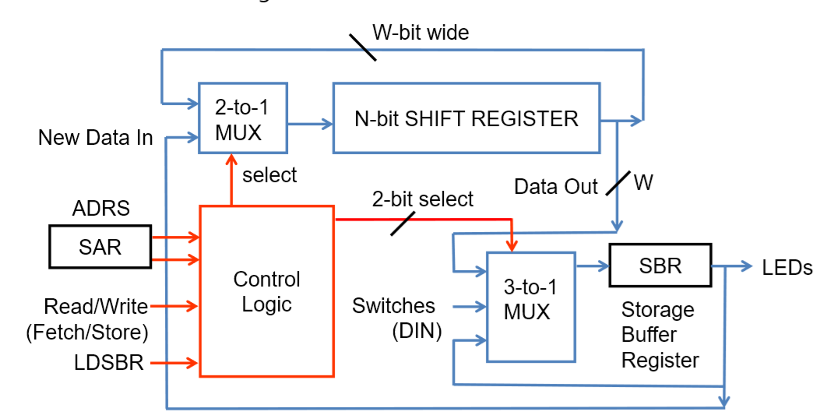
4. What is the RAM configuration we implement in Lab 2?
2 Words by 4 bits
4 Words by 2 bits
2 Words by 2 bits
4 Words by 4 bits
None of them

Slide 20
4. What is the RAM configuration we implement in Lab 2?
2 Words by 4 bits
4 Words by 2 bits
2 Words by 2 bits
4 Words by 4 bits
None of them
Notes:
We have 4 words, each word consist of 2 bits. Number of word == number of different address {0,1,2,3}

Slide 21
5. In Lab2, assuming SAR is set to 01 at during clock cycle 0, what’s the (assume NO delay in combinational path) minimum and maximum clock cycle to have valid data in SBR?
0 and 4
1 and 3
1 and 4
2 and 3
2 and 4

Slide 22
5. In Lab2, assuming SAR is set to 01 at during clock cycle 0, what’s the (assume NO delay in combinational path) minimum and maximum clock cycle to have valid data in SBR?
0 and 4
1 and 3
1 and 4
2 and 3
2 and 4
★ ★
Counter = 01 @ cycle 0 → valid on next cycle
Counter = 10 @ cycle 0 → wait 3 more cycle to get 01 at shift-out and 1 more to write to SBR

Slide 23
6. How many TTL chip(s) need clock input in the list below?
1.Comparator(7485) 2.4-1 MUX(74153)
3.D-Flipflop(7474) 4.Shift Register(74194)
5.Asynchronous Counter(7493)
6.Synchronous Counter(74193) 7. NAND Gate (7400)
1
2
3
4
5

Slide 24
6. How many TTL chip(s) need clock input in the list below?
1.Comparator(7485) 2.4-1 MUX(74153)
3.D-Flipflop(7474) 4.Shift Register(74194)
5.Asynchronous Counter(7493) (counter always need clock!)
6.Synchronous Counter(74193) 7. NAND Gate (7400)
1
2
3
4
5
★

Slide 25
7. The Serial Logic Processor you built in Lab 3. If you use only 2 states to build it, what FSM is it?
A Moore Machine
A Mealy Machine
A Von-Neumann Machine
A Harvard Machine
A Modified Harvard Machine

Slide 26
7. The Serial Logic Processor you built in Lab 3. If you use only 2 states to build it, what FSM is it?
A Moore Machine (requires more states)
A Mealy Machine
A Von-Neumann Machine (computer architecture)
A Harvard Machine (computer architecture)
A Modified Harvard Machine (computer architecture)
★

Slide 27
In Lab 3, if a Moore Machine was used instead, what is the minimum number of states?
1
2
3
5
6

Slide 28
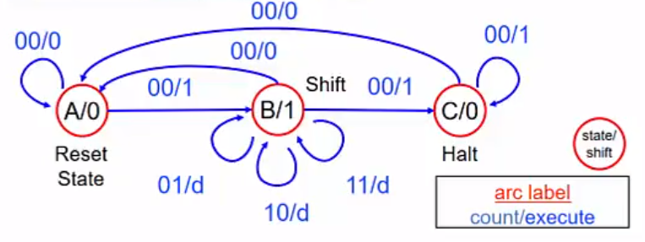
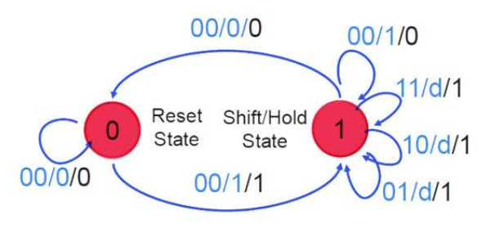
In Lab 3, if a Moore Machine was used instead, what is the minimum number of states?
1
2
3
5
6
Notes:
For mealy machine, the output (shift) depends on EXE(input) and Q(state), but for moore, it only depend on state (need two bits for Q)

Slide 29
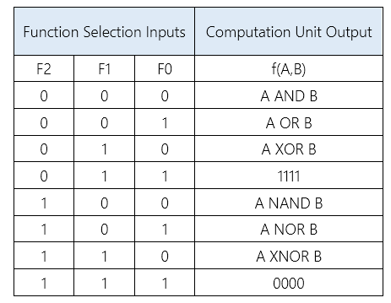
8. In Lab 3. If you don’t have a 8:1 MUX and only have first 4 functions implemented, how many ways below can use to you achieve the function selection for 8 functions?
1.Only use one 2:1 MUX and one 4:1 MUX
2.Only use two 4:1 MUX
3.Only use three 2:1 MUX
4.Only use a 4:1 MUX and an XOR gate
5.Only use a 4:1 MUX and a NOR gate
0
1
2
3
4 or 5

Slide 30
8. In Lab 3. If you don’t have a 8:1 MUX and only have first 4 functions implemented, how many ways below can use to you achieve the function selection for 8 functions?
1.Only use one 2:1 MUX and one 4:1 MUX
2.Only use two 4:1 MUX
3.Only use three 2:1 MUX
4.Only use a 4:1 MUX and an XOR gate
5.Only use a 4:1 MUX and a NOR gate
0
1
2
3 F1 F0 controls 4:1 MUX
4 or 5 F2 controls XOR, like a “conditional inverter”
★★

Slide 31
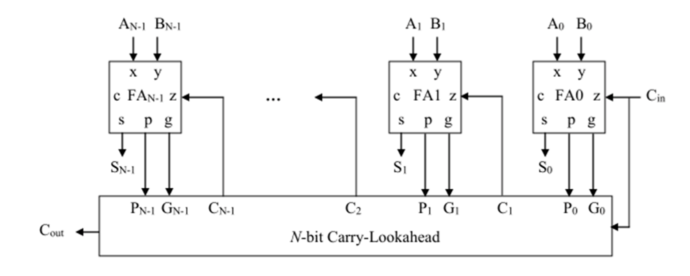
9. If FULL ADDER has delay (from A,B,Cin to S,Cout) 2ns;N-bits
AND, OR, XOR gates all have delay 1ns. What’s the smallest total latency of 4-bit CRA and 4-bit CLA? (gates can have any-bit input)
Assuming all input are valid at t=0ns. The time it takes for ALL output being valid is:
8ns, 8ns
10ns,8ns
8ns, 5ns
10ns,5ns
7ns,5ns

Slide 32
9. If FULL ADDER has delay (from A,B,Cin to S,Cout) 2ns;
N-bit AND, OR, XOR gates all have delay 1ns. What’s the smallest total latency of 4-bit CRA and 4-bit CLA? (gates can have any-bit input)
Assuming all input are valid at t=0ns. The time it takes for ALL output being valid is:
8ns, 8ns
10ns,8ns
8ns, 5ns ★★★
10ns,5ns
7ns,5ns
C3 = G2 + P2G1 + P2P1G0 + P2P1P0Cin
Gn = An&Bn, Pn = An ^ Bn (xor) → xor,and,or,FA3 == 5ns
Notes:
（Caveat: This calculation only holds provided that the width of gates are not limitied! (which is not true in practice)

Slide 33

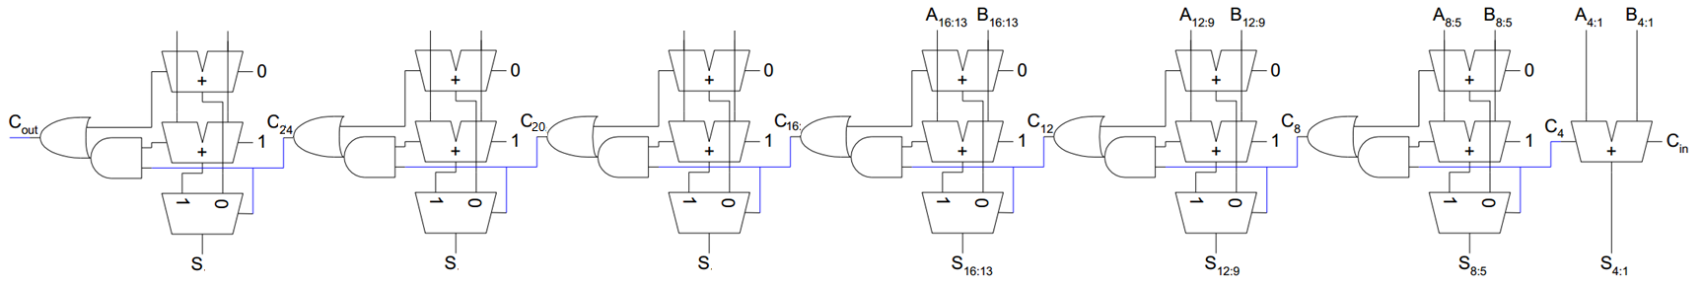
10. If we want to make a 28-bit CSA, we can simply use more 4-bit CSA modules. Can we make the CSA in Lab4 even faster?
Yes
No
(Suppose all 4-bit adders are built using hierarchical CSAs )
(i.e. Each you see here is a tiny CSA itself)

Slide 34
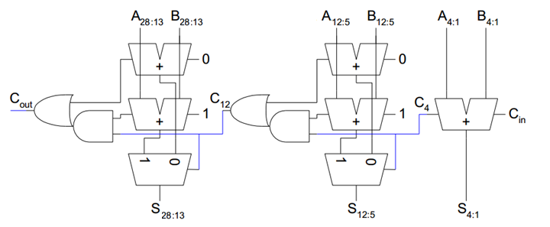
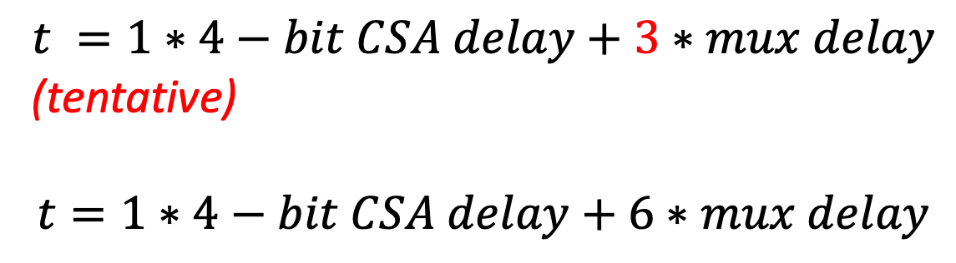
10. If we want to make a 28-bit CSA, we can simply use more 4-bit CSA modules. Can we make the CSA in Lab4 even faster?
Yes
No
Notes:
Trick is to make more significant bits wider

Slide 35
10. In Lab 5, if we extend the input to two 16 bit 2’s compliment numbers, what will be the maximum number of total ADD?
14
15 (The last turn must be a subtraction if it happens at all)
16
17
It depends
Notes:
i.e. there will not be the 16th add since if M=1, it must subtract. But if M is zero, we’re done with at most 15 adds.

Slide 36
11. In sLC3 design, what is the purpose of the provided tristate.sv?
To connect data from PC, ALU, MDR… to the BUS
To connect MEM2IO to the external SRAM
To connect BUS to SRAM
Both a and b
a, b and c

Slide 37
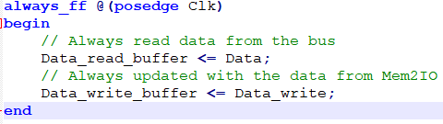
11. In sLC3 design, what is the purpose of the provided tristate.sv?
To connect data from PC, ALU, MDR… to the BUS
To connect MEM2IO to the external SRAM ★
To connect BUS to SRAM
Both a and b
a, b and c
Notes:
And it also buffers the output data

Slide 38
11. Which of the following SystemVerilog code will cause “always_comb does not infer purely combinational logic”?
a.//b and c are input logic [5:0] a; always_comb begin if(b == c) a = ~b; end | b.//b and c are input logic [5:0] a = 5’b0; always_comb begin if(b == c) a = ~b; end
c.//b and c are input logic [5:0] a; always_comb begin if(b != c) a = ~b; else a = b; end | d.//b and c are input logic [5:0] a; always_comb begin a = b; if(b == c) a = ~b; end
e. More than one will cause

Slide 39
11. Which of the following SystemVerilog code will cause “always_comb does not infer purely combinational logic”?
a.//b and c are input logic [5:0] a; always_comb begin if(b == c) a = ~b; end ★★ | b.//b and c are input logic [5:0] a = 5’b0; always_comb begin if(b == c) a = ~b; end
c.//b and c are input logic [5:0] a; always_comb begin if(b != c) a = ~b; else a = b; end | d.//b and c are input logic [5:0] a; always_comb begin a = b; if(b == c) a = ~b; end
if statement
must have
else or initial
value!
(case must have default)
e. More than one will cause

Slide 40
Problem background
In ECE 385, we usually enforce you to use
<= (non-blocking assignment) in always_ff, and
= (blocking assignment) in always_comb
However, a sophisticated FPGA engineer may not strictly follow this rule and may take advantage of the properties of these two kinds of assignment to simplify code.

Slide 41
In the following code, what would the value of A, B, C be after this clock cycle?
//assume A = 0, B = 1, C = 2 before
always_ff @ (posedge Clk) begin
B = A;
C = B;
End
a) 0, 1, 2
b) 0, 0, 1
c) 0, 0, 0
d 0, 2, 2
e) none of above

Slide 42
In the following code, what would the value of A, B, C be after this clock cycle?
//assume A = 0, B = 1, C = 2 before
always_ff @ (posedge Clk) begin
B = A;
C = B;
End
a) 0, 1, 2
b) 0, 0, 1
c) 0, 0, 0 ★★
d 0, 2, 2
e) none of above
A
B
C
Blocking assignment will really get evaluated line by line. Above code will be synthesized to:
Notes:
Non-blocking assignment will really get evaluated line by line. Above code will be synthesized to:

Slide 43
12. If a flip-flop has setup time 2ns, hold time 3ns, clock-to-output time 5ns, and the clock frequency is 50MHz. What is the longest allowed combinational path delay in one cycle?
20 ns
18 ns
15 ns
13 ns
10 ns

Slide 44
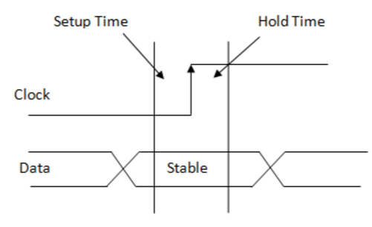
12. If a flip-flop has setup time 2ns, hold time 3ns, clock-to-output time 5ns, and the clock frequency is 50MHz. What is the longest combinational path delay in one cycle?
20 ns
18 ns
15 ns
13 ns ★ ★ ★
10 ns
13 = period – setuptime – clock-to-output-time (hold time is irrelevant for this cycle)
Notes:
Setup time removes time available for you to complete the path, cto time delays the arrival of your input. Hold time is the time that your

Slide 45
13. In a hypothetical 50MHz system. If Flipflop 1 has setup time 1ns, hold time 1ns, clk-to-out time 3ns, Flipflop2 has setup time 2ns, hold time 5ns, clk-to-out time 7ns, what’s MINIMUM allowed path delay?
1 ns
2 ns
3 ns
5 ns
8 ns

Slide 46
13. In a hypothetical 50MHz system. If Flipflop 1 has setup time 1ns, hold time 1ns, clk-to-out time 3ns, Flipflop2 has setup time 2ns, hold time 5ns, clk-to-out time 7ns, what’s MINIMUM allowed path delay?
1 ns
2 ns ★ ★ ★
3 ns
5 ns
8 ns
2 = 5(hold time of FF2)-3(c-to-o time of FF1)
Notes:
At 0ns, clock toggles, at 3ns, FF1 has valid output, if combinational path finishes less than 2 ns, then hold time of the second FF will be violated. The previous result of FF2 will not be stored.

Slide 47
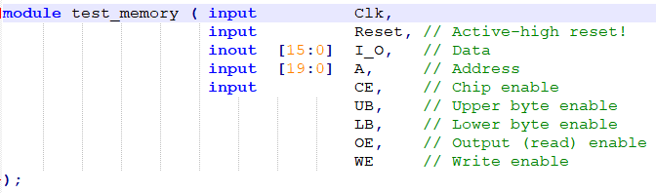
13. The storage element that test_memory.sv emulates is:
Register file
SDRAM
SRAM
Flash
On-chip-Memory

Slide 48
13. The storage element that test_memory.sv emulates is:
Register file
SDRAM
SRAM ★
Flash
On-chip-Memory

Slide 49
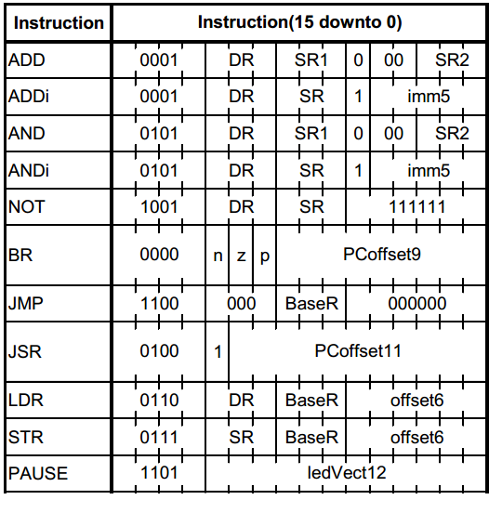
14. In Lab 6. If the instruction is 0001 000 001 100001 (Addi), ,and R0 has 0xFFFF, R1 has 0x0010, what is the condition code NZP after this operation?
001
101
100
010
000

Slide 50
14. In Lab 6. If the instruction is 0001 000 001 100001 (Addi), ,and R0 has 0xFFFF, R1 has 0x0010, what is the condition code NZP after this operation?
001 ★ (R0 <= 0x0010 + 0x0001 = 0x0011)
101
100
010
000

Slide 51
15. What is the correct way to connect port in SystemVerilog?
If I have: module M(input a, input b, output logic c);
in top level, I have logics A, B, C
M m0(.*);
M m0(.A(a),.B(b),.C(c));
M m0(.a(A),b(B),.c(C));
a and c
a and b

Slide 52
15. What is the correct way to connect port in SystemVerilog?
If I have: module M(input a, input b, output logic c);
in top level, I have logics A, B, C
M m0(.*); //(A != a, case sensitive)
M m0(.A(a),.B(b),.C(c));
M m0(.a(A),.b(B),.c(C)); ★
a and c
a and b

Slide 53
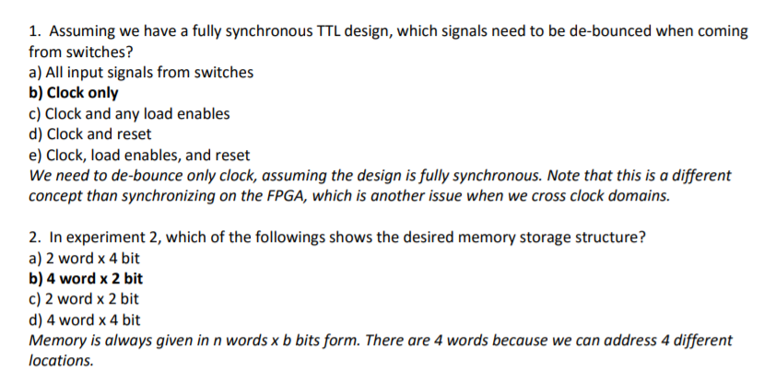
Speed Round - Questions On Given Practice Midterm?

Slide 54
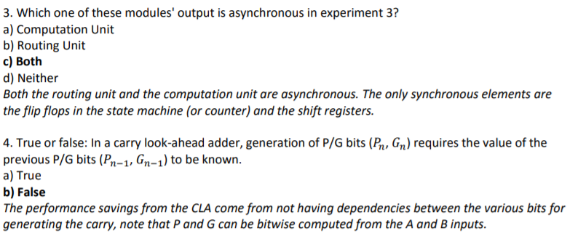
Speed Round - (Cont.)

Slide 55
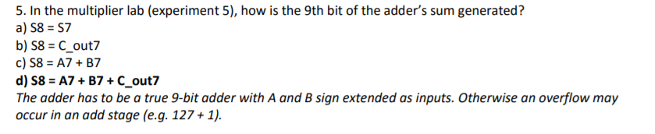
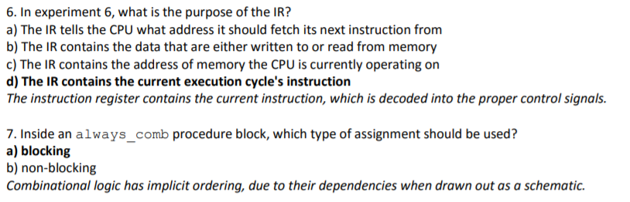
Speed Round - (Cont.)

Slide 56
Some Tips:
Memory is always given in m(words)*n(bits) form
In Lab5: the value in RegB is multiplier and the value from the switches is multiplicand
Static Hazard:
0-static-hazard: steady state is 0;
1-static-hazard: steady state is 1;

Slide 57
Study Resource
Course Wiki: Lecture Slides, Q/A session recording
Definitely study the Post-lab Questions!
Spending the same time on Exam would probably earn you more points than spending that much time on the Final Project
Notes:
Although initial block can’t be synthesized, it actually doesn’t need to synthesize it at all. The synthesis tool will read from the specified file and initialize the OCM.

Slide 58
Spend your time wisely
If you don’t think you can get the answer to the question, skip it. It’s better to show off what you know than what you don’t know.
Notes:
Although initial block can’t be synthesized, it actually doesn’t need to synthesize it at all. The synthesis tool will read from the specified file and initialize the OCM.

Slide 59
End of Review Session
Good luck!

